Slide 1


Records Retention Schedule Design
Justin Anderson
Ojie Okodogbe
Priyanshu Gupta
AMTRAK

Slide 2
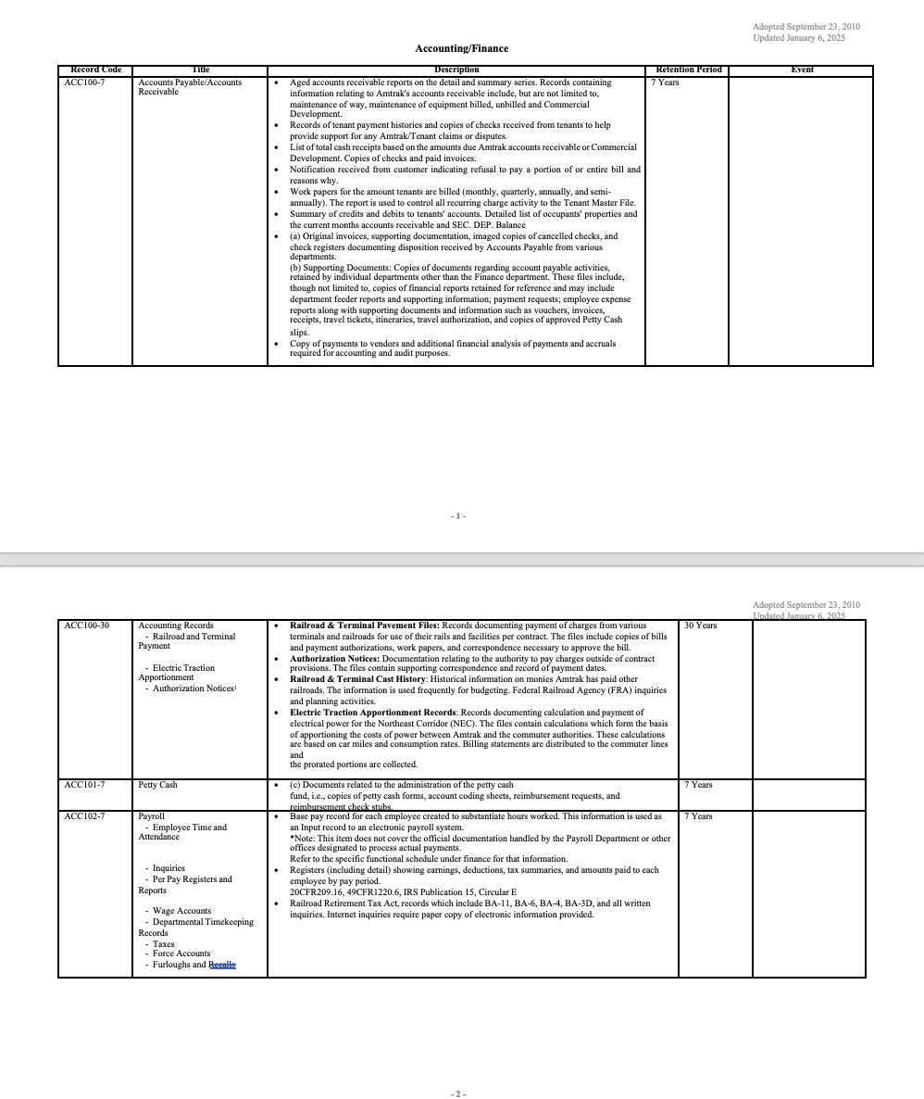
Challenge
Transform a static, dense, 75-page PDF document that is difficult to:
Navigate
Search
Update
Into:
A more interactive and accessible solution
Outcome:
Providing a modernized digital approach to records retention at Amtrak

Slide 3
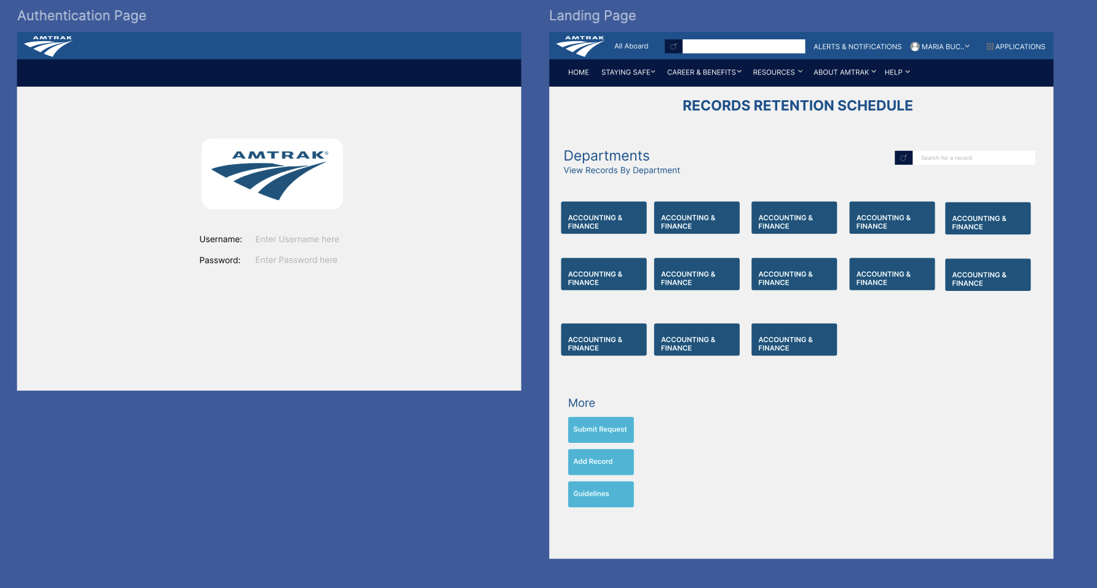
A Web-Based Solution:
A Figma Prototype
Figma Prototype was developed
BUT..
Instead of wireframes, what if we created an actual implementation?

Slide 4
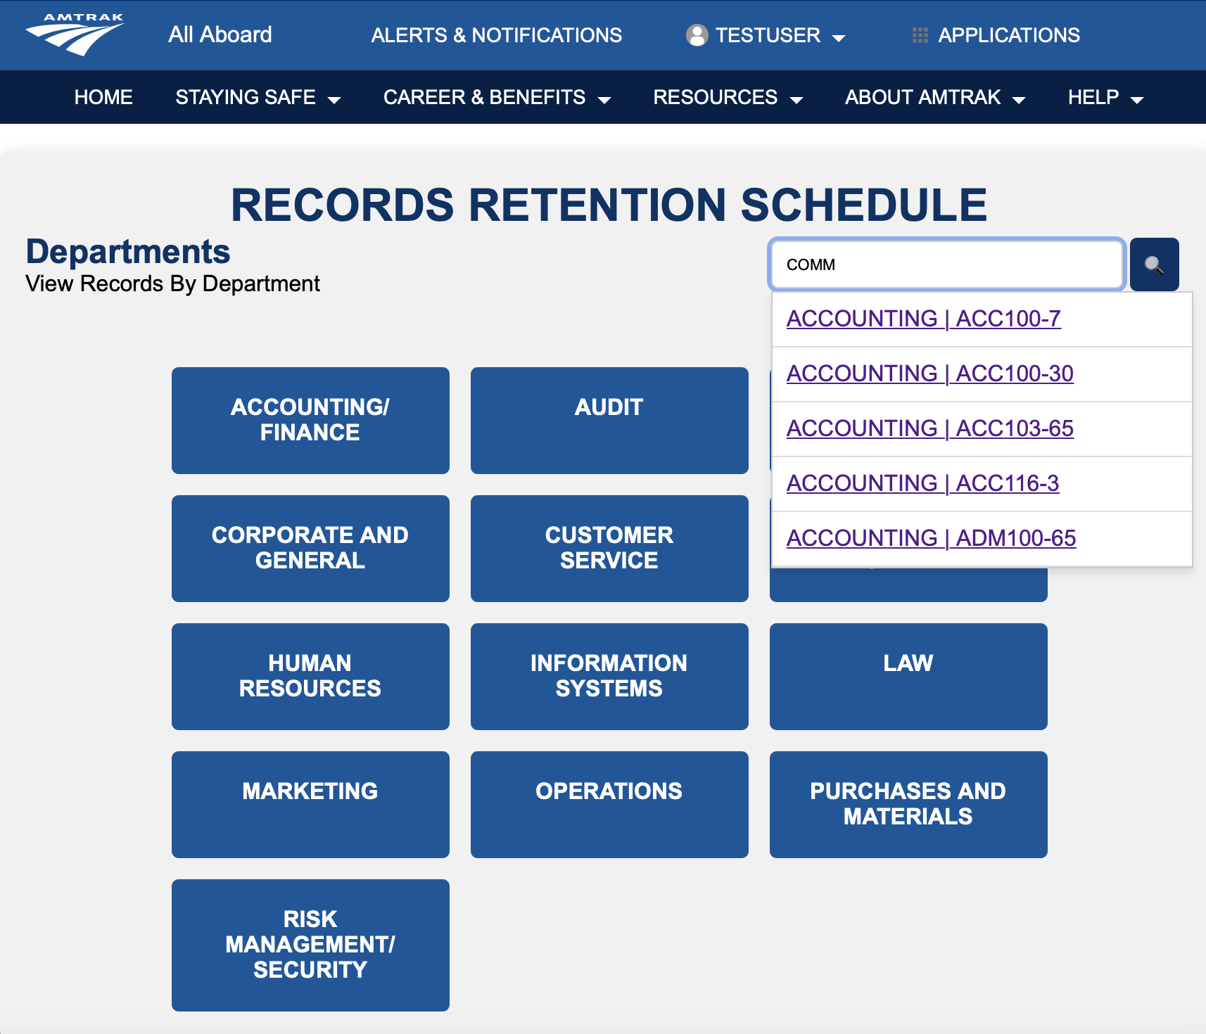
Full Stack Solution:
Full Stack Development:
HTML, CSS, JS, PHP
A template.html created for use within each of the 13 .php files.
Each .php file included a script (JavaScript) for reading and searching through respective .csv files.
XAMPP was utilized to provide a locally-hosted Apache web server to ensure the pages were interactive and functional.
Tools Used: Visual Studio Code, XAMPP/Apache, StackOverflow, W3Schools, Mozilla Dev. Network

Slide 5
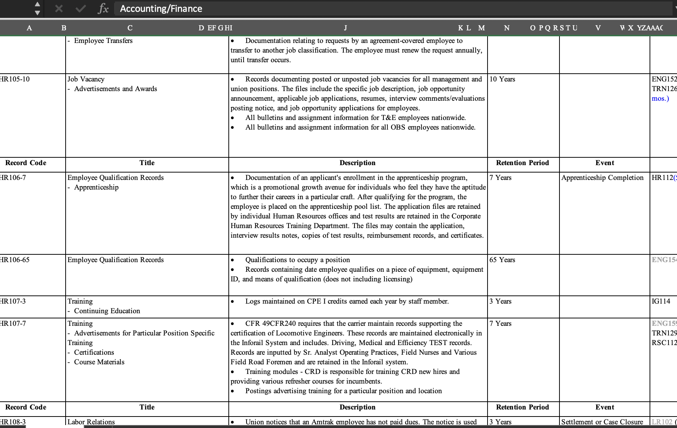
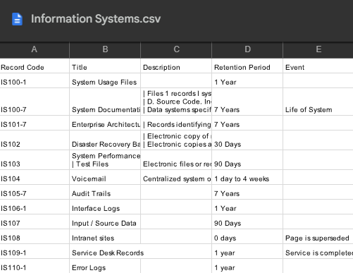
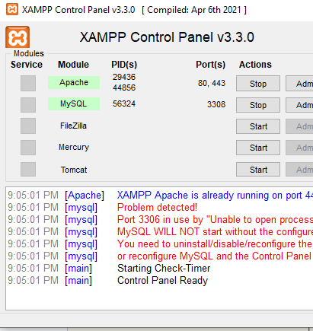
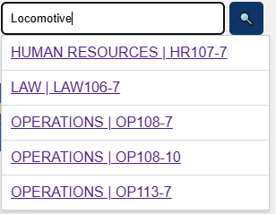

Challenges Faced:
Corrupted .docx
.CSV Files
Server required
Dynamic Search
How to parse?
How to include?
HTML vs PHP
PHP and JS

Slide 6
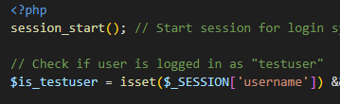

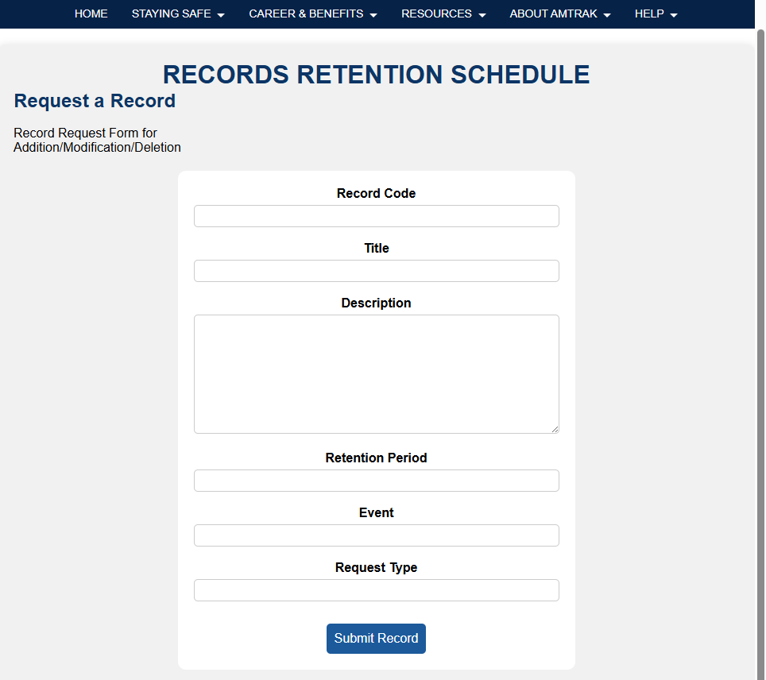
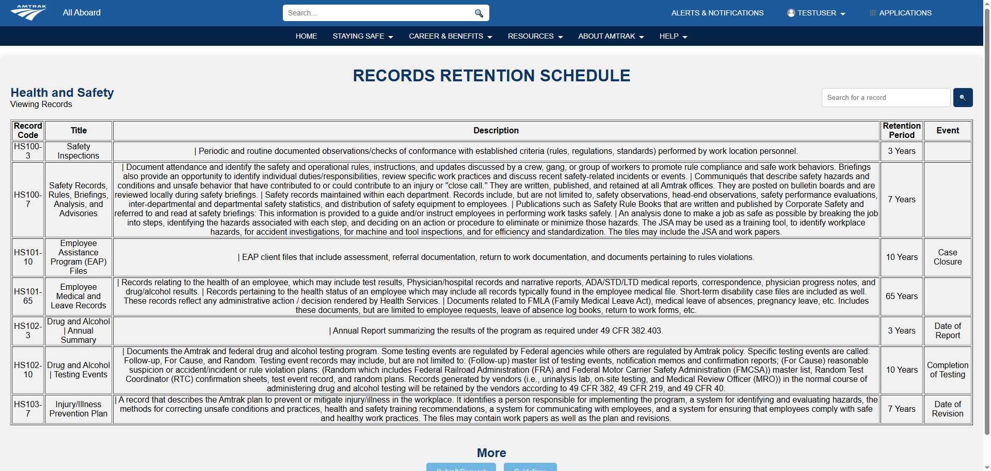
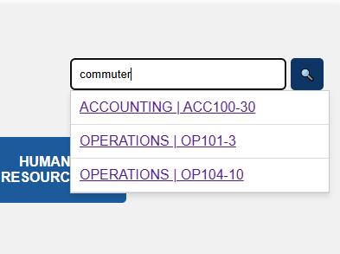
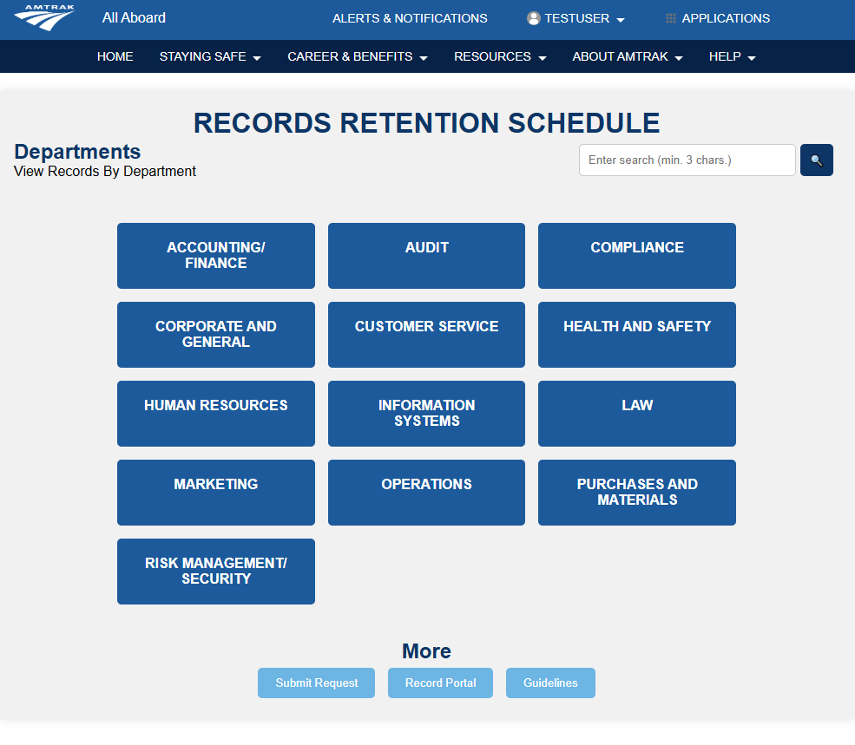
Main Features
Live Search for department-specific PHP pages
Live Search for department-wide entries
Friendly and accessible user interface
Scalable-ready;
RBAC can exist

Slide 7

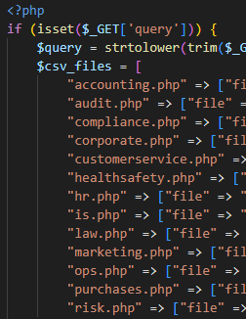
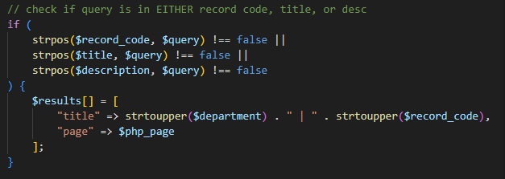
How Live Search Works
This JavaScript fragment is for department-specific record filtering
This JavaScript fragment allows for live indexing/searching
This PHP fragment matches the user’s query to a substring; results array to display resulting matches
This PHP fragment is where each dept.-specific page is matched to their respective CSV

Slide 8
